Slide 1

Electronics(in USA) - EDA
En Ching and Michael

Slide 2
Domain Background
Manufacturers and merchants have always faced a critical issue in setting prices.
Pricing strategy sometimes focuses on market share objectives, while at other times it concentrates on competitors by either engaging in price cartels or destroying them.
More often than not, setting the overall price position against other products in the same category, or against competitors have been a challenge in consumer electronics.
One of the biggest determinators of success is getting pricing right: priced too low and profitability is broken, plus it is almost impossible to later increase the price (substantially). Launch at too high a price and you may not sell enough to get off the ground.
It is beneficial that manufacturers and merchants to base their pricing on data rather than costs, competitors or guesses.

Slide 3
Problem Statement
The goal is to know what factors impact pricing strategies for the products listed by merchants, based on the trends or patterns in the ways merchant do their pricing strategies for their products.

Slide 4
Datasets and Inputs
Dataset containing a list of over 7,000 electronic products (some are same products) with pricing, manufacturer, product type information etc
Assumptions / Considerations
As we don’t have data on the quantity sold, all these products at those prices are deemed to be “comparable”.
No additional factors such as tax to affect the prices
Products listed in same categories are comparable across brands.
No external shock factors within the 2 years worth data (2017 and 2018).

Slide 5
Project Design
Workflow
Data Gathering / Understanding
Data Cleaning
Data Pre-Processing & Feature Engineering
EDA / Visualization
Conclusion

Slide 6
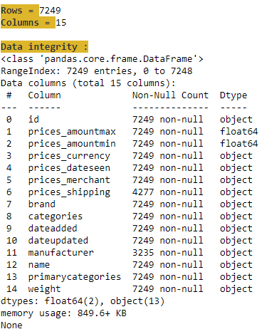
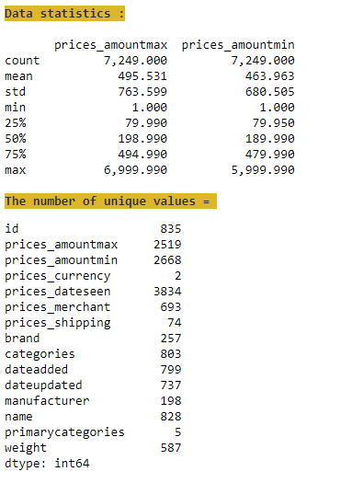
1. Data Gathering / Understanding

Slide 7
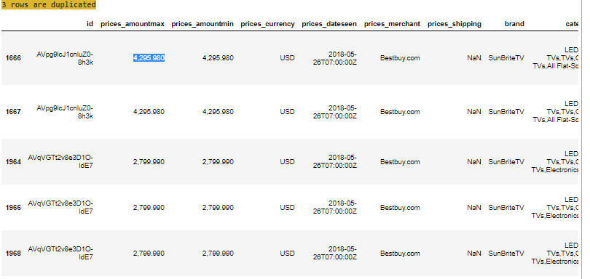
2. Data Cleaning - Duplication

Slide 8
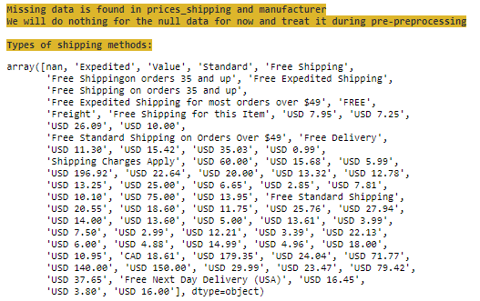
2. Data Cleaning – Missing Data

Slide 9
3. Data Pre-processing & Feature Engineering
Shipping : Indicate whether shipping is provided, and whether it’s free shipping or there’s a shipping cost charged to buyers (Add columns - “shipping_provided”, “shipping_free” and “shipping_charges”; Drop column – “prices_shipping”)
Currency : Change non USD-denominated prices to USD (Drop Column – “prices_currency”)
Weight: All existing weight are converted and standardised to grams (Add column – “weight_grams”; Drop Column – “weight”)

Slide 10
3. Data Pre-processing & Feature Engineering
Price: An estimated price is tagged to each date of observation based on the assumptions of a simple linear regression (Add column – “est_price”; Drop columns – “prices_amountmax”, “prices_amountmin” and “prices_dateseen”)
Date: Binning the dates into Month and Year (Add columns – “month” and “year”)
Merchants: Identify the top 3 merchants vs others (label other merchants as “others”)

Slide 11
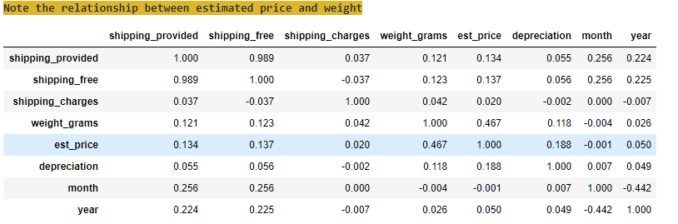
3. Data Preprocessing & Feature Engineering
Correlations analysis on the main features identified

Slide 12
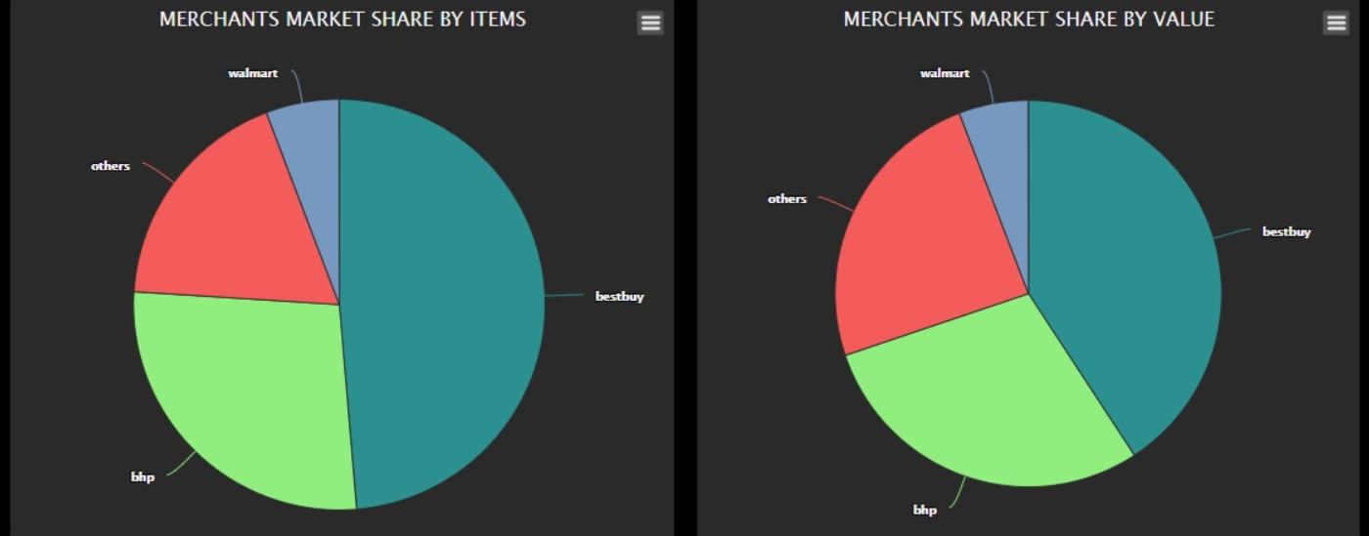
4. EDA / Visualization
a. Top Merchants

Slide 13
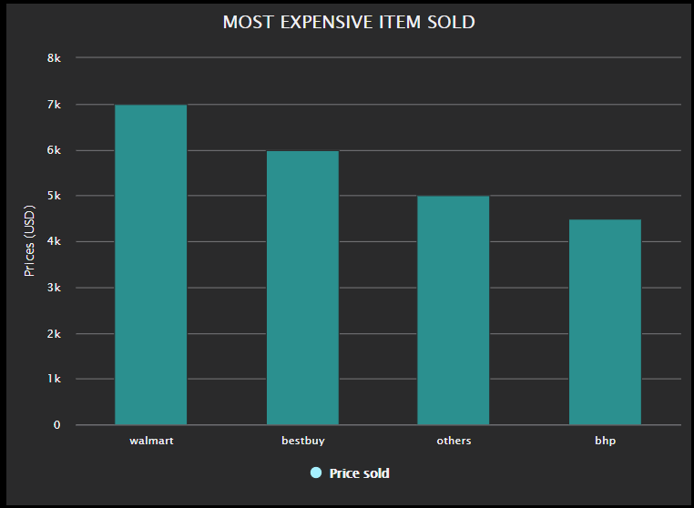
4. EDA / Visualization
b. Most expensive items (by merchants)

Slide 14
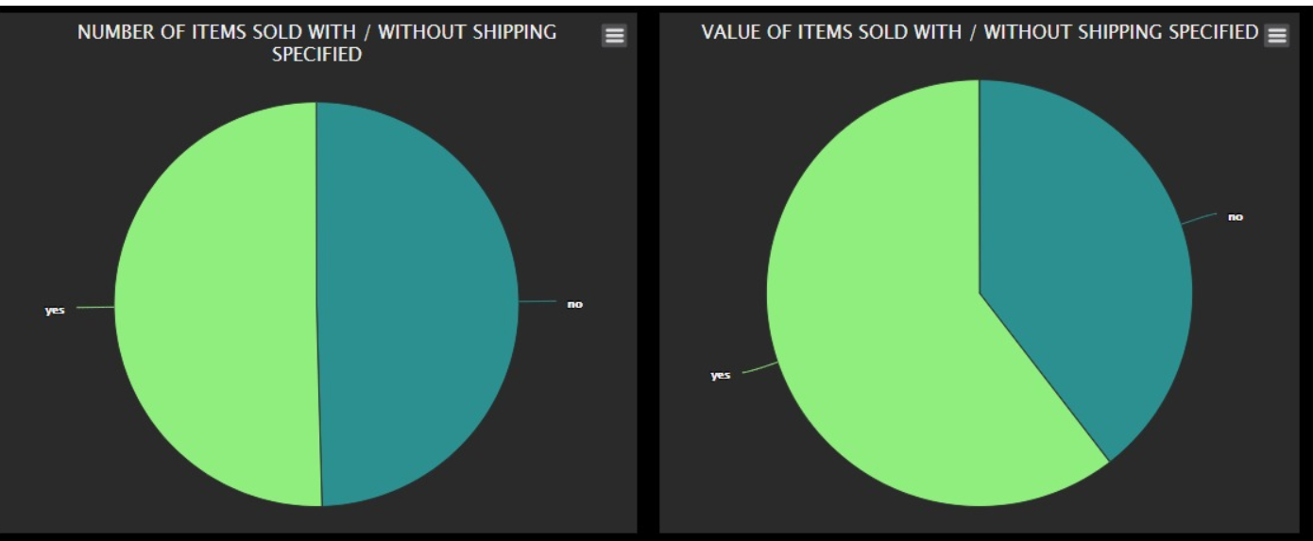
4. EDA / Visualization
c. Items sold with/without shipping

Slide 15
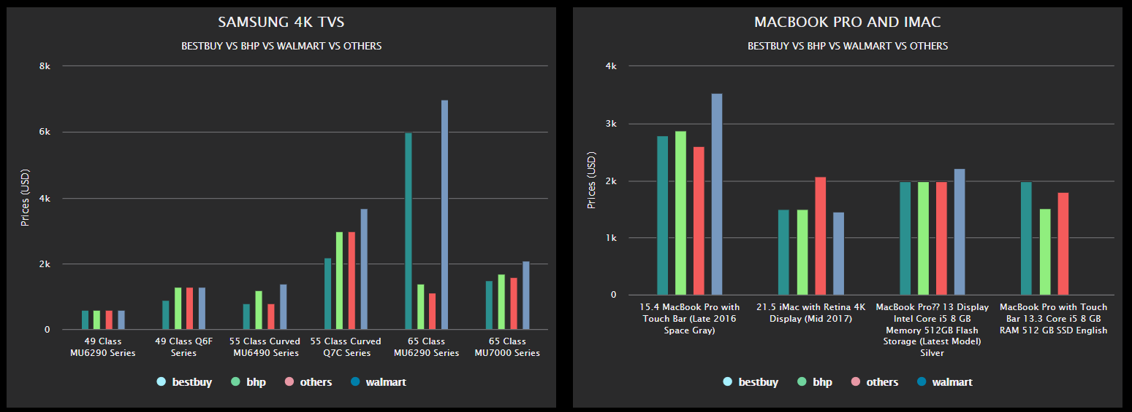
4. EDA / Visualization
d. Samsung TVs and Macbook Pro & iMac (by merchants)

Slide 16
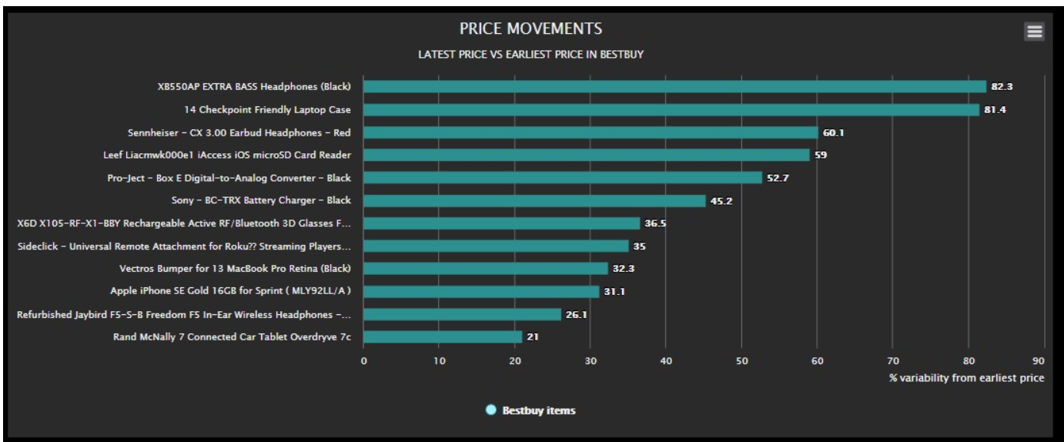
4. EDA / Visualization
e. Compare price movement (for items in bestbuy)

Slide 17
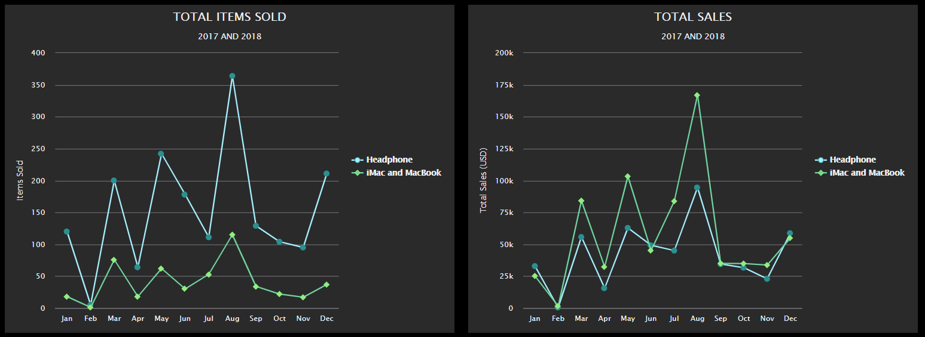
4. EDA / Visualization
f. Seasonality

Slide 18
5. Conclusion
Insights
Merchant: Walmart, BestBuy and BHP are the biggest merchants/players in the US electronic market. They also sell the most expensive priced electronic products in the market.
Shipping: Shipping does not affect the demand of a product.
Pricing: Bigger well-known merchants does not necessarily sell their products cheaper than other merchants.
Depreciation: Certain product categories does not tend to be cheaper over-time (for eg. Headphones)
Seasonality: Highest electronic sales occur in the month of August (end of summer break).

Slide 19
Q&A

